Slide 1
Machine Learning Techniques to Detect DDoS Attacks on VANET System: A Survey
Alia Mohammed Alrehan , Fahd Abdulsalam Alhaidari
College of Computer Science and Information Technology,
Imam Abdulrahman Bin Faisal University, saudi arabia
2019 2nd International Conference on Computer Applications & Information Security (ICCAIS). IEEE, 2019. p. 1-6.

Slide 2
Outline
Abstract
Section 1: Introduction
Section 2: Background
Section 3: Literature review
Section 4: Discussion and analysis
Section 5: Conclusion and future work

Slide 3
Abstract
Intelligent Transport System (ITS) reduced road traffic accidents and enhanced quality citizens’ quality of life.
VANET improved road safety and in provided travelers comfort.
VANET technology is exposed to many vulnerabilities like Distributed Denial of Service (DDoS) attack led to security threats.
The main attacks along with DDoS attack on VANET system
Potential solutions focused on securing VANET based on machine learning to detect the attacks
Notes:
智慧型交通系統是將先進的資訊科技、通訊技術、傳感技術、控制技術及電腦技術等有效率地整合運用於整個交通運輸管理體系，而建立起的一種在大範圍內及全方位發揮作用的，即時、準確及高效率的綜合的運輸和管理系統。
有路側裝置對車輛(Roadside-to-Vehicle ，R2V)的網路架 構外，更有著車輛對車輛(Vehicle-to-Vehicle，V2V)的溝通模式，如此減少了基礎建設的使 用，進而節省大量的佈建成本。再者，利用此 V2V 的架構，即使在缺少基礎建設的鄉村地 區，也能有基本車間網路可供使用。

Slide 4
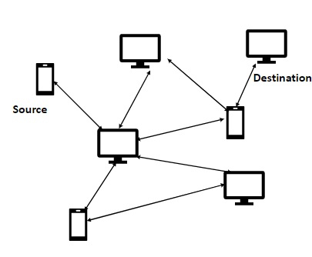
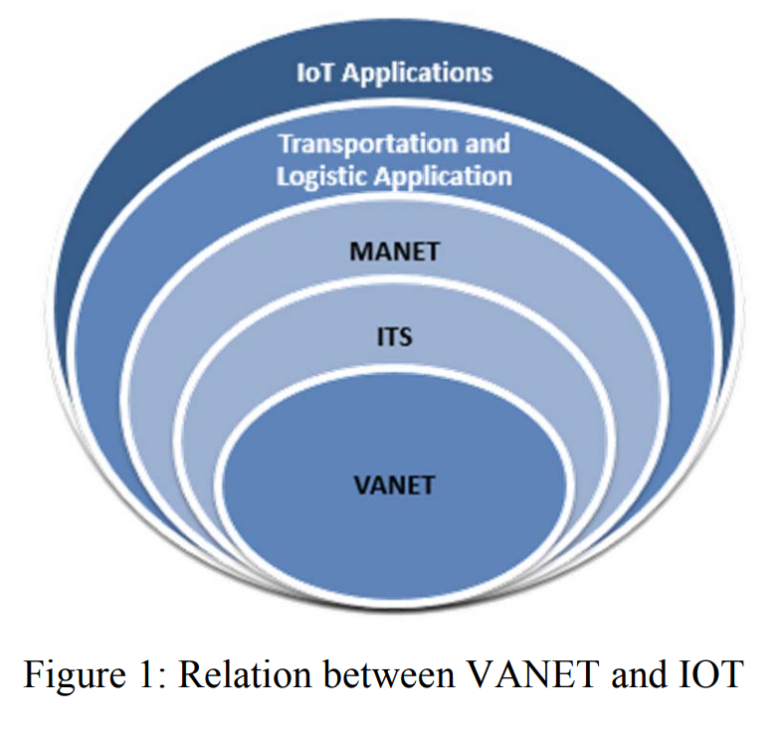
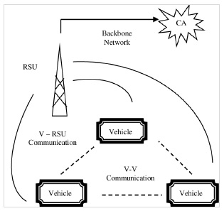
Introducion
MANET
RSU
OBU
OBU
OBU
VANET
Notes:
Internet of Things(IoT)物聯網應用
MANET=Mobile Ad Network=WANET=Wireless Ad Network
Intelligent Transport System (ITS) 智慧型交通系統 ->基礎建設耗費資源
VANET頻寬寬、拓樸變換快、擴展性大、能源受限大、移動性高、節點移動方向單一、分布稀疏離散

Slide 5
Introdustion
In Eastern Mediterranean , 1.25 million deaths / year and 45% of road traffic deaths caused by car accident. Saudi government imposed of traffic rules and applied monitoring system like Saher system to reduce the rate of the accidents.
VANET main goal:concentrating on the safety of drivers, passengers, and the vehicle itself.
3 types of communication in VANET:
1.vehicle to vehicle communication (V2V)
2.vehicle to infrastructure (V2I)
3.road side unit (RSU) to RSU (I2I) communication
Notes:
在沙烏地阿拉伯的交通事故、死傷人數很高，
Saher 系統是一種自動化系統，用於主要城市的電子系統控制和管理交通。採用數碼相機網路技術連接到內政部國家信息中心。網路可對違規行為進行技術檢查，然後從數據庫中請求所有者的信息，發布超速的違規行為並切斷信號以提高水平的交通安全。
車輛相當於VANET的節點，每個節點配置在On-Board Unit (OBU).
分享關於交通與車輛意外的機密資訊

Slide 6
Introducion
VANET which is high mobility and large size of network, the whole network can be interrupted and compromised if any node exchanging a malicious information.
Different attacks:
Confidentiality: Eavesdropping, traffic analysis
Integrity: Masquerade, Black hole, and Replay attacks
Availability: Jamming, Denial of Service (DoS), and Distributed Denial of Service (DDoS) attacks
Notes:
在節點間快速交換資訊
在Background介紹VANET的時候會講到漏洞與攻擊

Slide 7
Introducion
Section 2: Introduce VANET
Section 3: existing mechanisms and techniques to detect and prevent attacks in VANET environment
Section 4: discusses and analyses recent literature review
Section 5: conclusion of the study
Notes:
在節點間快速交換資訊
機密性攻擊:竊聽、流量分析
設備完整性攻擊
可用性攻擊

Slide 8
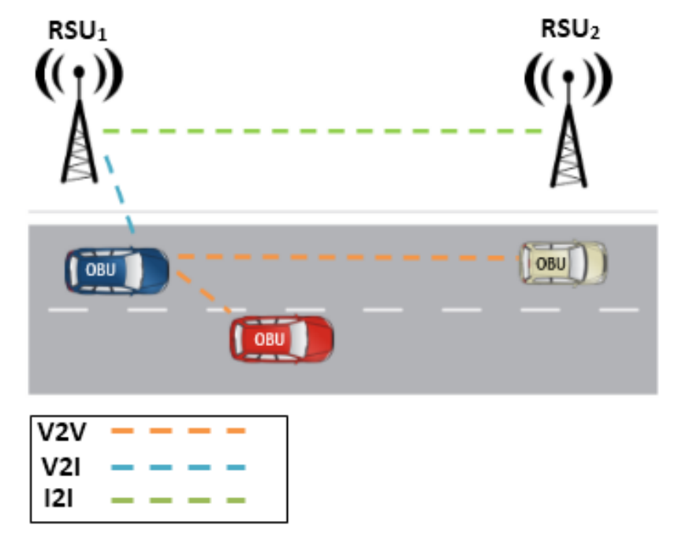
Background
Components in VANET : Application unit (AU), On-Board Unit (OBU), and Roadside unit (RSU)
3 types of communication in VANET:
1. vehicle to vehicle communication (V2V)
2. vehicle to infrastructure (V2I)
3. road side unit (RSU) to RSU (I2I) communication
VANET Architecture
Notes:
在節點間快速交換資訊
機密性攻擊:竊聽、流量分析
設備完整性攻擊
可用性攻擊

Slide 9
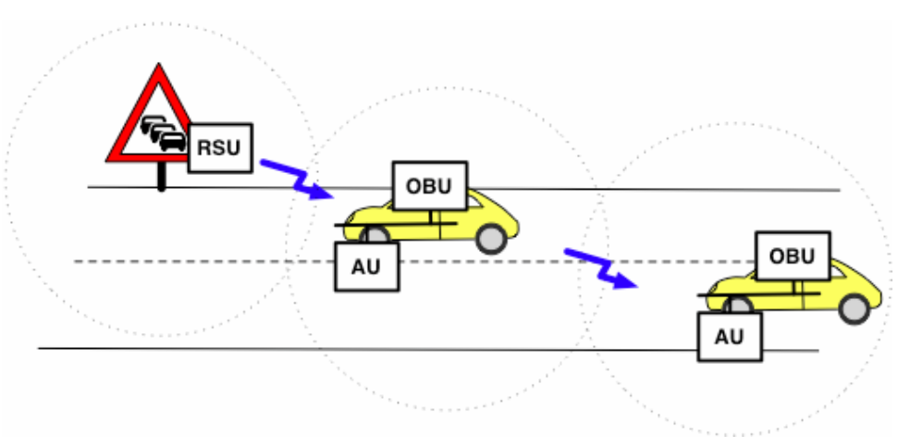
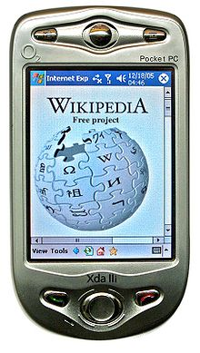
Background
Functions of On-Board Unit,Application Unit,and Road Side Unit
OBU: a wave device for reliable message transfer, ad hoc and geographical routing, network congestion control, wireless radio access, data security, and IP mobility
AU: a device includes an application or user interface through a wired or wireless connection (e.g.,PDA)
RSU:
1. Extending the communication range
2. Running safety applications
3. Providing Internet connectivity to OBUs.
Personal Digital Assistant
Notes:
AU: 使用OBU的溝通能力，進行有線或無線的溝通
RSU: 傳送訊息到其他RSU即可轉送至更多OBS、使用I2V來傳送不同類型的警告訊息

Slide 10
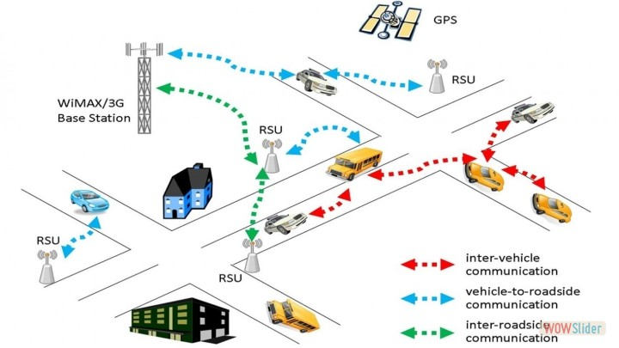
Background
VANET unique characteristics:
Predictable mobility
No power constraints
Rapid changes in network topology
Large-scale network
High computational ability
Challenges of VANET:
network size
information verification
highly dynamic nature
frequent disconnection
usage of wireless channels to exchange messages
key distribution
forwarding algorithms
Notes:
可預測的行動:交通號誌、紅綠燈、道路方向
沒有永久能源:沒汽油就無法使用
網路拓樸迅速改變因為節點可能一直在移動(高速公路)
大範圍網路:城市、小鎮、高速公路
高計算能力:同時間大量節點間要不斷交換資訊 不論是V2V、V2I、I2I
網絡規模、高度動態性、頻繁斷開連結、使用無線通道交換消息、訊息驗證、密鑰分發和轉發演算法

Slide 11
Literature review-Vulnerabilities in VANET
4 categories VANET attacks:
1. Routing: gray/black hole attack, and Sybil attack
2. Integrity: Masquerade, Black hole, and Replay attacks, and alteration attack
3. Confidentiality: Eavesdropping, traffic analysis
4. Availability: Jamming, Denial of Service (DoS), and Distributed Denial of Service (DDoS) attacks, and spamming attacks
Notes:
路由攻擊: 女巫攻擊-個人試圖通過偽裝成多個帳户身份， 透過多個節點或電腦坐標從而控制網絡。
設備完整性攻擊
機密性攻擊:竊聽、流量分析
可用性攻擊

Slide 12
Literature review-Vulnerabilities in VANET
4 categories VANET attacks:
1. Routing: gray/black hole attack, and Sybil attack
2. Integrity: Masquerade, Replay attacks, and alteration attack
3. Confidentiality: Eavesdropping, traffic analysis
4. Availability: Jamming, Denial of Service (DoS), and Distributed Denial of Service (DDoS) attacks, and spamming attacks
Attack equipment:
the wireless interface, hardware and software, sensors input in the vehicle, and infrastructure
Notes:
路由攻擊: 女巫攻擊-個人試圖通過偽裝成多個帳户身份， 多個節點或電腦坐標從而控制網絡。
設備完整性攻擊: 偽裝攻擊-通常包含其他類型的主動式攻擊、黑洞攻擊-藉由丟棄封包的阻斷服務攻擊、重送攻擊-偽裝後竄改資訊給第三者、
機密性攻擊:竊聽、流量分析-利用常見的流量分析工具來收取被害者的資訊 (側錄到的網站交易內容)
可用性攻擊: 阻斷服務、分散式阻斷服務DDoS
(CAs or vehicle manufacturer)

Slide 13
Literature review-Vulnerabilities in VANET

Slide 14
Literature review-DDoS Attack in VANET

Slide 15
Literature review-DDoS Attack in VANET

Slide 16
Literature review-DDoS Attack in VANET

Slide 17
Literature review-DDoS Attack in VANET

Slide 18
Literature review-Usage of Machine Learning for VANET

Slide 19
Literature review-Usage of Machine Learning for VANET

Slide 20
Literature review-Usage of Machine Learning for VANET

Slide 23
SlidesCarnival icons are editable shapes.
This means that you can:
Resize them without losing quality.
Change line color, width and style.
Isn’t that nice? :)
Examples:

Slide 24
Diagrams and infographics

Slide 25
You can also use any emoji as an icon!
And of course it resizes without losing quality.
How? Follow Google instructions https://twitter.com/googledocs/status/730087240156643328
✋👆👉👍👤👦👧👨👩👪💃🏃💑❤😂😉😋😒😭👶😸🐟🍒🍔💣📌📖🔨🎃🎈🎨🏈🏰🌏🔌🔑 and many more...

Slide 26

Free templates for all your presentation needs
For PowerPoint and Google Slides
100% free for personal or commercial use
Ready to use, professional and customizable
Blow your audience away with attractive visuals

